Slide 1
Using R to Promote Data Interoperability in the Atmospheric Science Community
Josh Roberti, Robert Lee
Cody Flagg, Lee Stanish
10 January 2017
Austin, TX
Annual AMS Conference

Slide 2
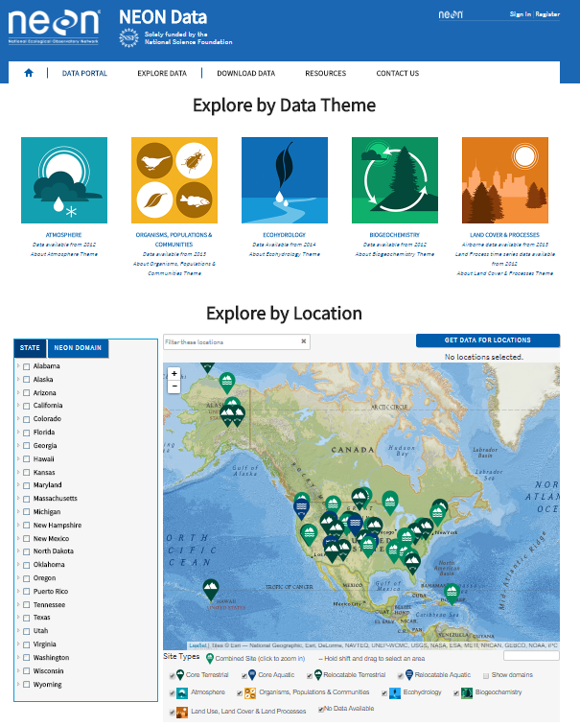
“NEON?... I’ve never heard of it”
Continental-scale ecological Observatory
Open-access data, resources and infrastructure
Standardized measurements
Enable understanding and prediction of the effects of human activities on ecology
30-year time Observatory
2012 - 2017 (Construction Phase)
Building towers
Installing sensors
Algorithm Development
Data QC development
Data Commissioning
2018 onwards (Operational Phase)

Slide 3
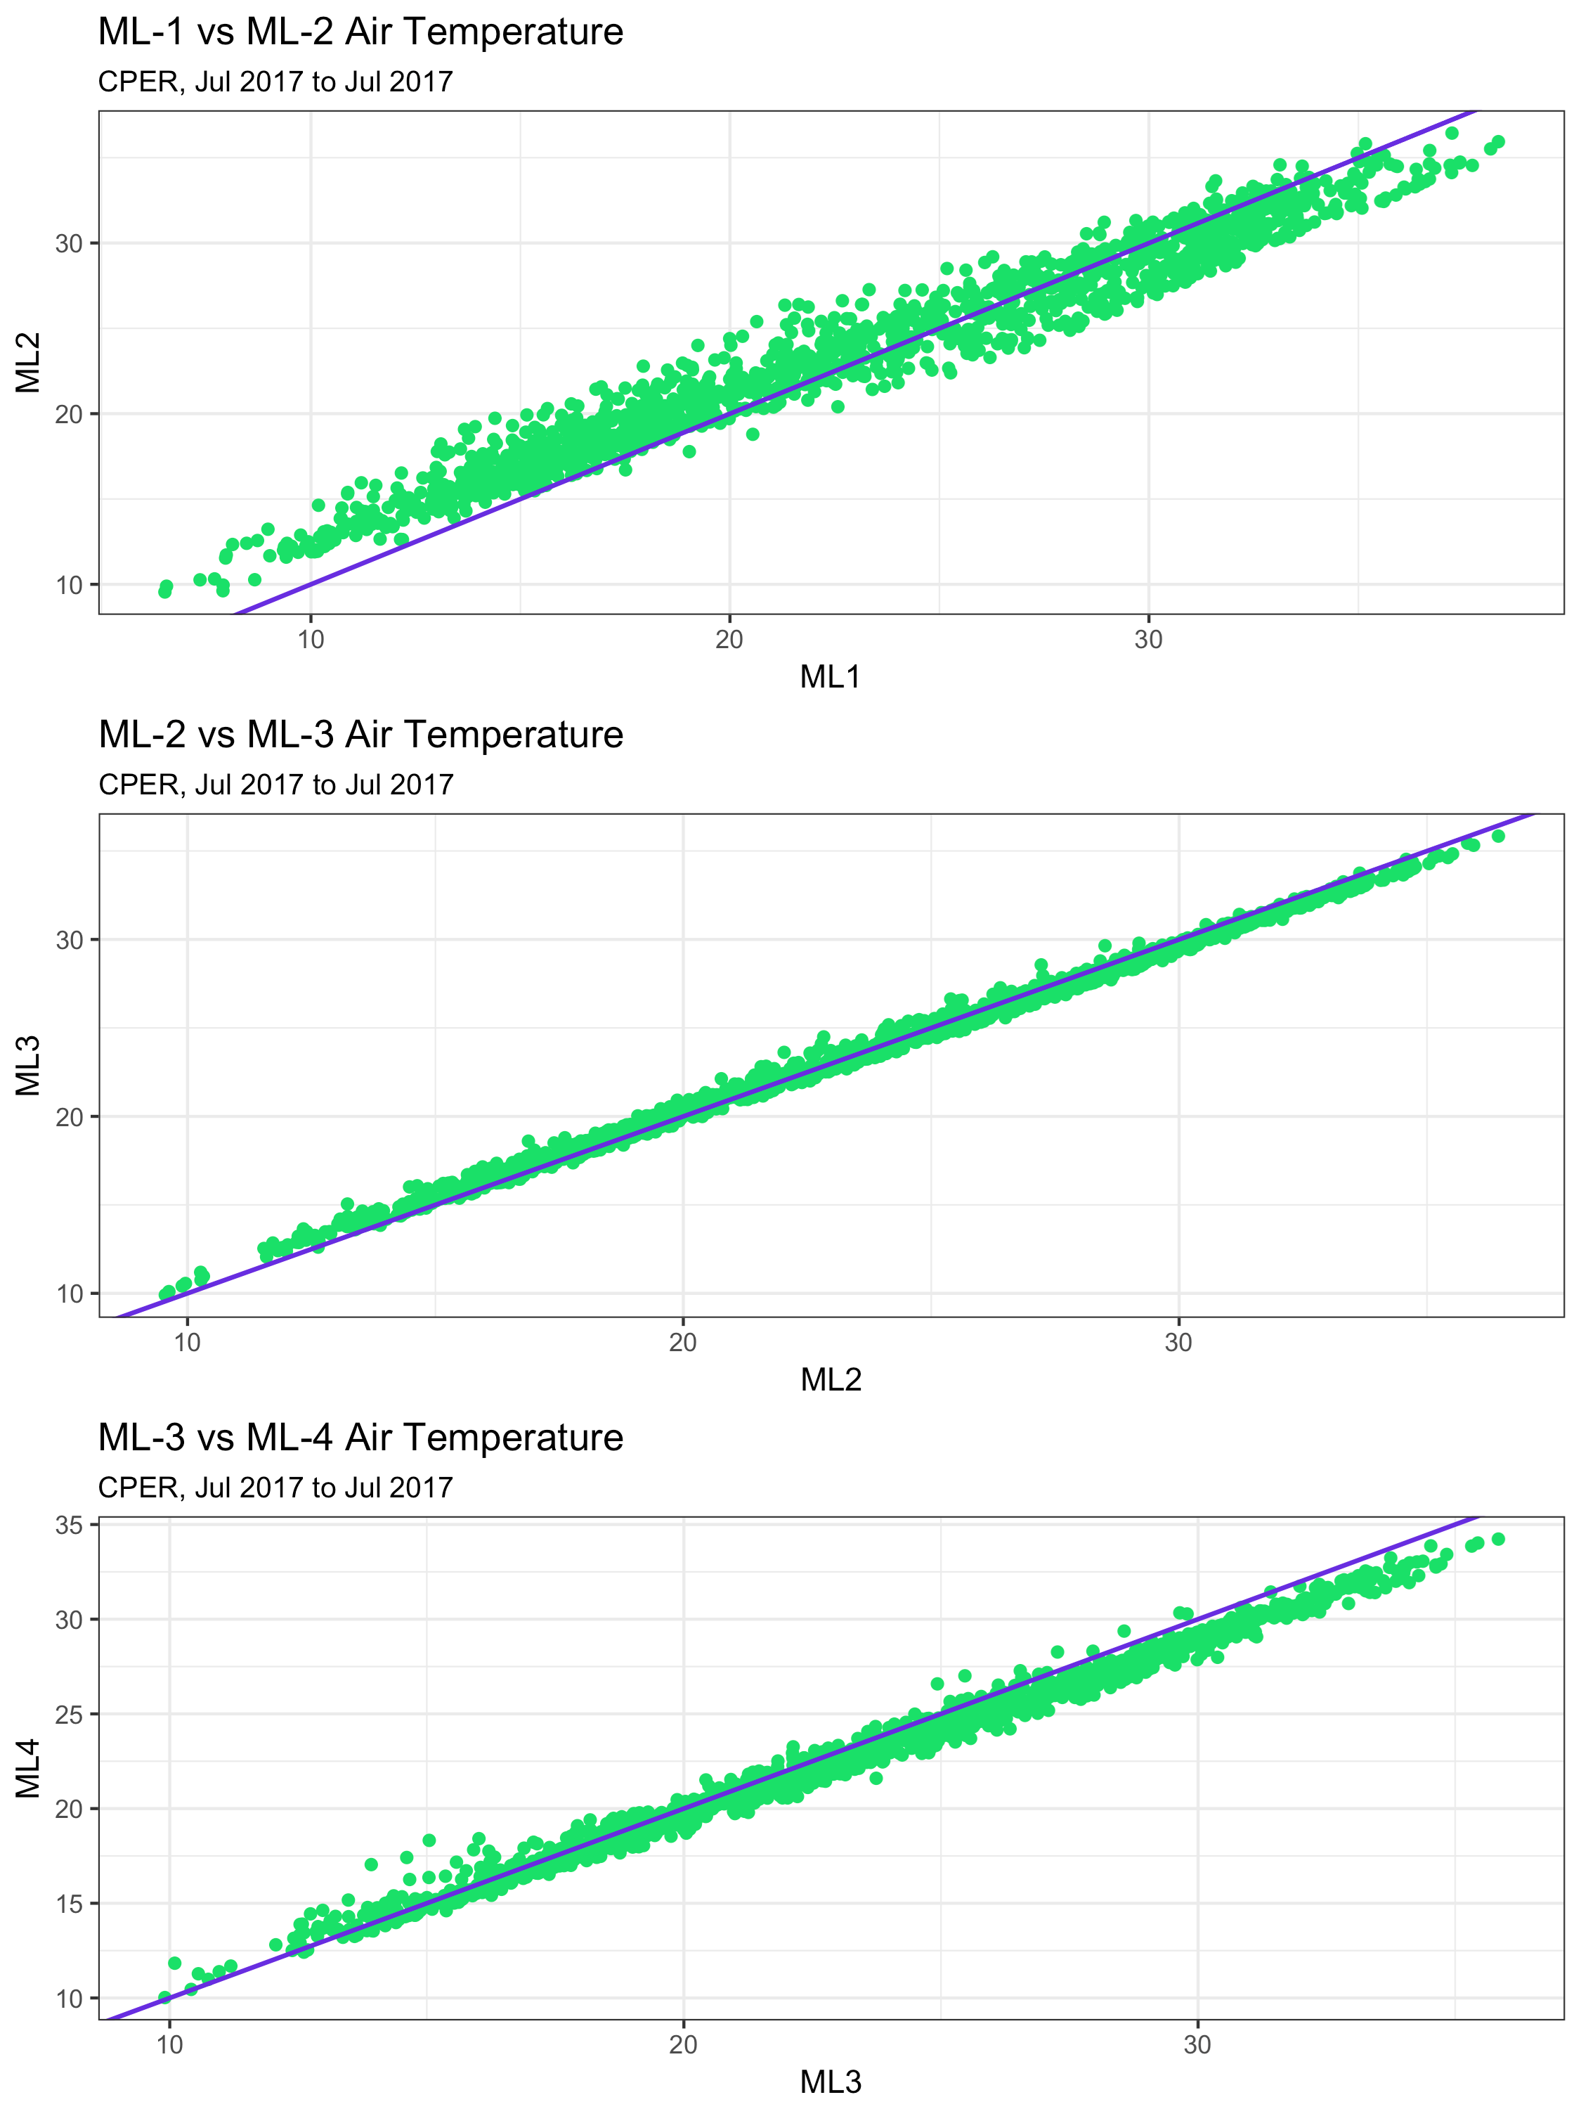
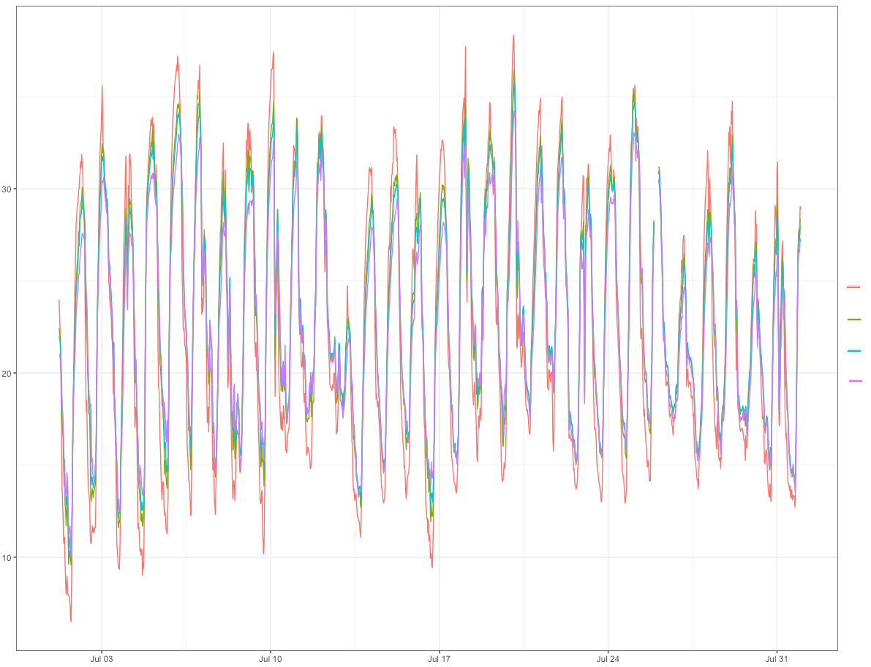
NEON data commissioning
Instrumented Systems (IS) Commissioning examines NEON data health by:
Verifying data quantity (> 95% availability)
Verifying data validity with internal quality reporting (> 90% pass QC tests)
Examining the health of data loggers
Examining correlations of data at different measurement heights
NEON-CPER
℃
ML 1
ML 2
ML 3
ML 4
Date

Slide 4
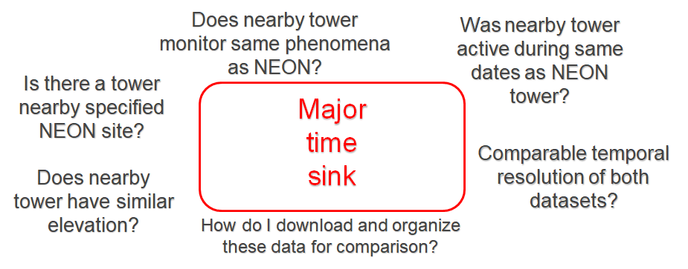
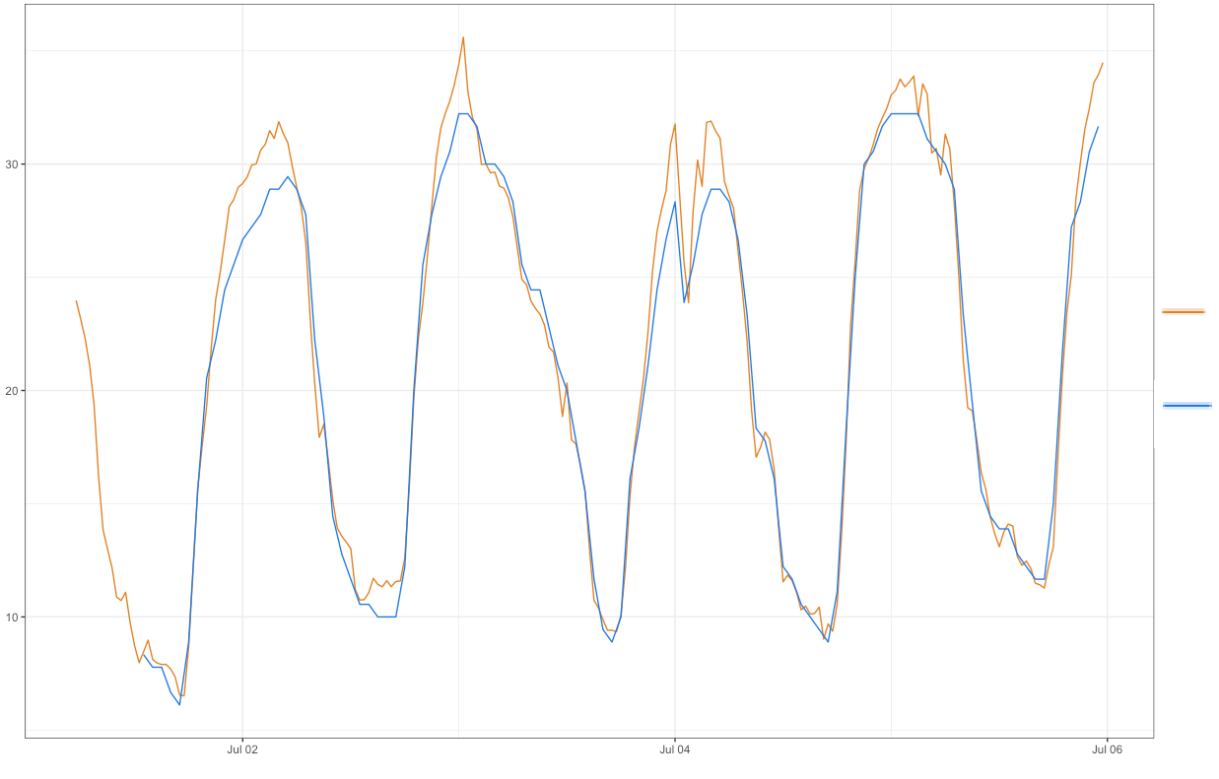
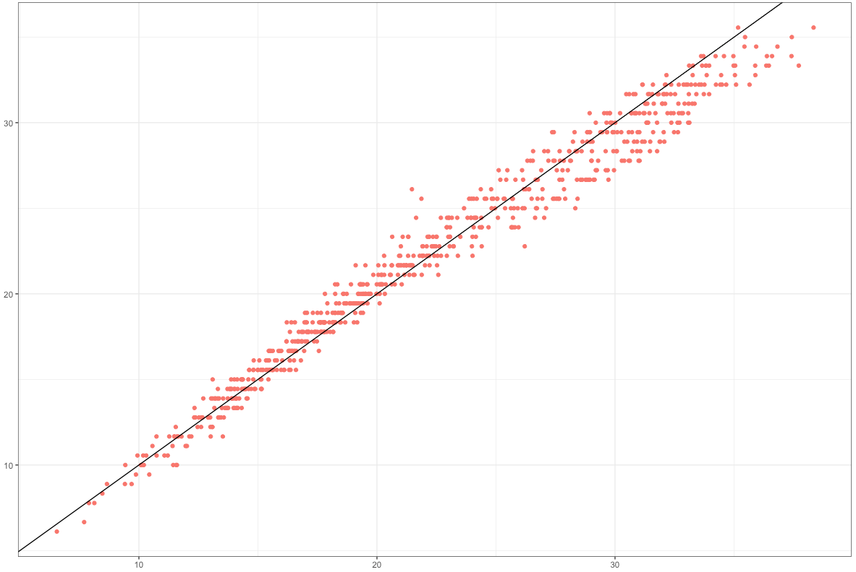
NEON data commissioning
Examining correlations between NEON data and data from nearby non-NEON sites
℃
NEON-CPER
SCAN-2197
SCAN-2197
Date
NEON-CPER

Slide 5
The Bigger Picture
I need [environmental phenomena] data from [spatial region of interest]
observed between [start date] to [end date].
Need accurate station metadata!!
Site Name(s)
Site IDs (e.g., NCDC, WBAN, GHCND)
Platform(s) (e.g., COOP, AWOS, NEON)
Geolocation data
Latitude
Longitude
Elevation
Variables measured (e.g., air temp, precipitation, etc.)
Sensor information (type of equipment used, e.g. tipping bucket, SRG, etc.)
Dates
absolute dates (site)
active dates for each measured phenomenon
Temporal Resolution of data product(s)

Slide 6
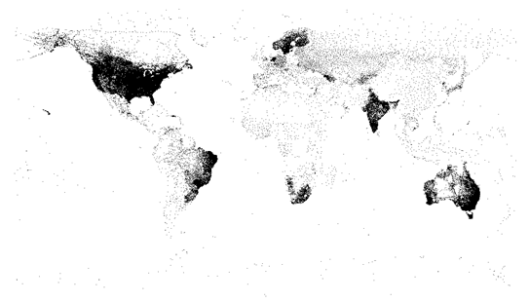
metScanR
What is it?
A tool for locating, mapping, and gathering environmental data and metadata, worldwide.
>107,000 environmental monitoring stations among 219 countries/territories

Slide 7
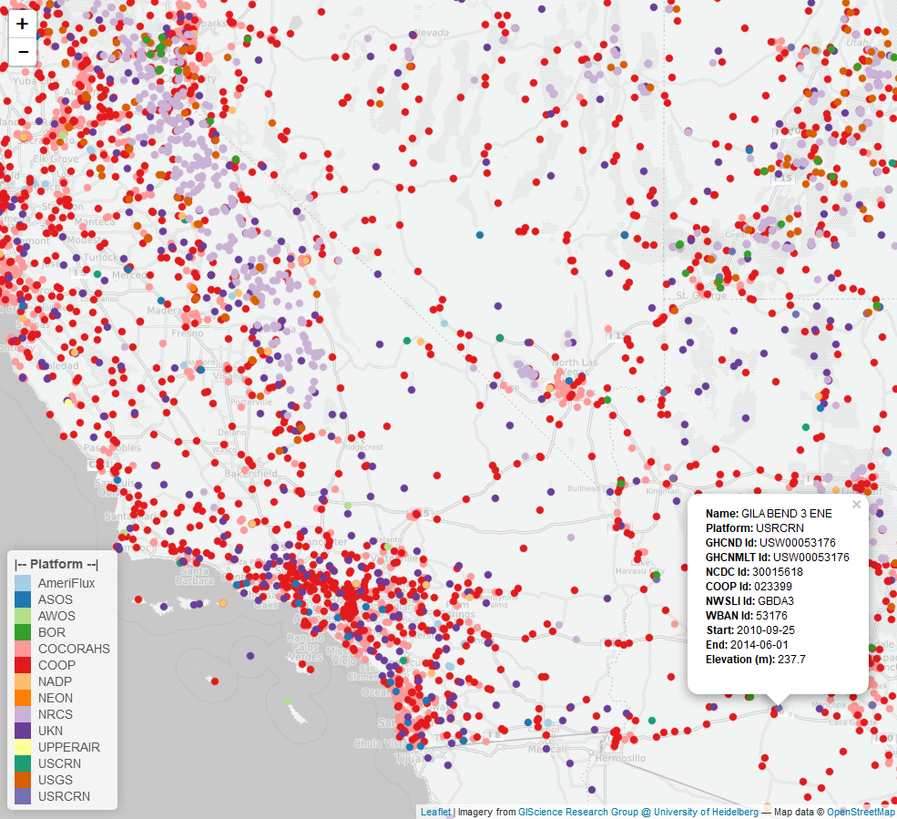
metScanR
Features
Mitigates time sink
Users can search for and filter metadata from via:
Elevation
Location
Lat / Lon
Nearby POI
Active dates
Elements Measured
Country
Network type
ID type
Station ID
Station IDs Allow data to be downloaded from numerous databases

Slide 8
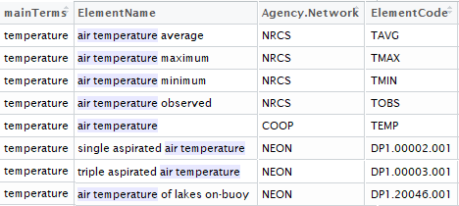
N-gram Search
Implemented a hierarchical n-gram search tool to account for nomenclature discrepancies among all networks.
N-grams:
n-gram | Definition | Example
Uni-gram | One word | Temperature
Bi-gram | Two words | Air Temperature
Tri-gram | Three words | Minimum Air Temperature Maximum Air Temperature Average Air Temperature Mean Air Temperature Air Temperature Mean Air Temperature Maximum Air Temperature Average Air Temperature Minimum …
ElementCode is needed for downloading data via Network APIs

Slide 9
N-gram Database
Currently comprises 456 n-grams pertaining to environmental data. The database (usually) grows when metadata from additional networks are added.

Slide 10
Who collects the data?
Government funded organizations with different goals and missions…
"provide leadership on food, agriculture, natural resources, rural development, nutrition, and related issues based on sound public policy, the best available science, and efficient management.”
[https://www.lwv.org/a1-united-states-department-agriculture]
“To understand and predict changes in climate, weather, oceans, and coasts, to share that knowledge and information with others, and to conserve and manage coastal and marine ecosystems and resources.”
[http://www.noaa.gov/about-our-agency]
“enable understanding and forecasting of the impacts of climate change, land use change and invasive species on continental-scale ecology – by providing infrastructure and consistent methodologies to support research and education in these areas.”
[http://www.neonscience.org/observatory/about]
“provide the scientific community, policy makers, and society with the knowledge and predictive understanding necessary to conserve, protect, and manage the nation's ecosystems, their biodiversity, and the services they provide.”
[https://lternet.edu/node/20]
Notes:
Put the visio diagram with all the agencies and sub networks etc. Find mission statements of each network / observatory. Show simple depiction of

Slide 11
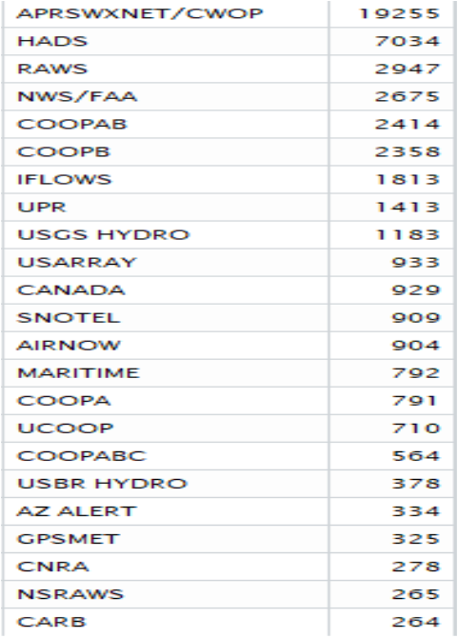
Collecting Environmental Data
Notes:
Put the visio diagram with all the agencies and sub networks etc. Find mission statements of each network / observatory. Show simple depiction of

Slide 12
Collecting Environmental Data
Notes:
Put the visio diagram with all the agencies and sub networks etc. Find mission statements of each network / observatory. Show simple depiction of

Slide 13
Storing Environmental Data
Multiple data repositories managed by different organizations results in discrepancies in:
Nomenclature

Slide 14
Use Cases

Slide 15
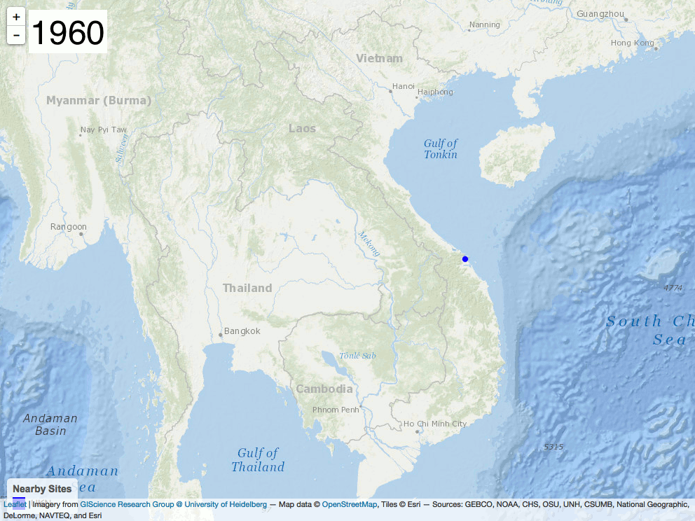
Vietnam War loop

Slide 16
metScanR GUI

Slide 17
Future Goals
Package updates every 3 to 6 months
New functions to filter data by:
US State
Temporal availability of data
Additions of following networks:
LTER
LTAR
ARM
GNIP
[list other networks]
Data downloads and merging (link metScanR to other R packages):
RNRCS – NRCS data
nneo – NEON data
rnoaa – NOAA / HOMR data
“NEON’s open-access data, resources and infrastructure will enable scientists, educators, planners, decision makers and the public to map, understand and predict the effects of human activities on ecology and effectively address critical ecological questions and issues.”

